Slide 1
Machine learning stock price prediction
Terence Chan Alex Lam

Slide 2
Aim
Using machine learning to analyse and predict stock price
PROJECT
Business Value
INTRODUCTION
With the support of machine learning, user will have more confidence when making investment decision
Method
Logistic Regression, Naïve Bayes, K-Nearest Neighbours, Decision Tree, Random Forest and Time Series

Slide 3
Library used
yfinance
sklearn.metrics
Numpy
matplotlib.pylab
Prophet, prophet.plot
statsmodels.tools.eval_measures
Pandas
math

Slide 4




Target Company
Tesla (TSLA)
A
Is an American multinational automotive and clean energy company. CEO: Elon Musk
Nio (NIO)
B
Is a Chinese multinational automobile manufacturer. CEO: William Li
Twitter (TWTR)
C
Is an American communications company. CEO: Elon Musk
Meta (META)
D
Is an American multinational technology conglomerate. CEO: Mark Zuckerberg

Slide 5
Business Values
Why are we doing this?
To predict target companies stock price of the next trading date and identify trend
Who are the affected/beneficial parties?
Target company shareholder
What are the major stakeholder involved?
Elon Musk as the owner of Tesla and Twitter.

Slide 6
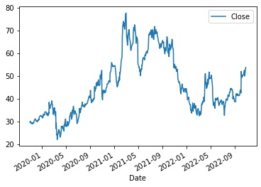
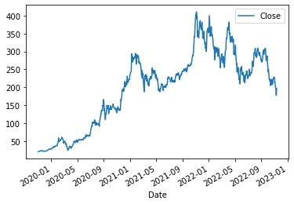
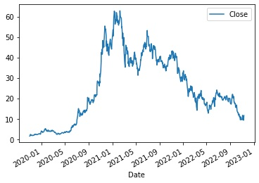
Historical Stock Price
Nov 2019 till Oct 2022
Twitter
Tesla
Nio
Twitter delisted from New York Stock exchange on November 8
From 2020 till early 2022, Tesla stock price was in an upward slopping trend
Nio is one of Tesla’s major competitor

Slide 7
Project Workflow
Machine Learning
Time Series
Machine Learning
Classification
Data Processing
Data Collection
Logistic Regression
Naïve Bayes
K-Nearest Neibhbours
Decision Tree
Random Forest
Compare and contrast which MODEL with the highest accuracy on one handpicked stock
Use the best model to project the November stock price trend
Using yfinance
It is an open-source tool that uses Yahoo’s publicly available APIs, and is intended for research and educational purpose
Information collected:
Tesla, Nio and Twitter stock price (High, Low, Open and Close)
Period: Nov 2019 till Oct 2022
Delete unnecessary column (such as: Dividends, Stock Splits)
Add another column as target (df['Close'] > df['Close'].shift(1)) which mean stock price goes up, if 0, then mean price drop

Slide 8
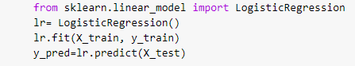

Logistic Regression
Tesla
Twitter
Precision Score: 54.09%
Precision Score: 63.64%
NIO
META
Precision Score: 43.64%
Precision Score: 43.42%

Slide 9
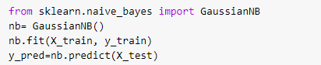
Naïve Bayes
Tesla
Twitter
Precision Score: 68.75%
Precision Score: 62.71%
NIO
META
Precision Score: 44.74%
Precision Score: 43.42%

Slide 10
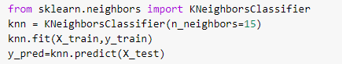
K-Nearest Neighbours
Tesla
Twitter
Precision Score: 52.83%
Precision Score: 68.42%
NIO
META
Precision Score: 44%
Precision Score: 47.17%

Slide 11
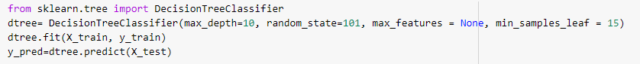
Decision Tree
Tesla
Twitter
Precision Score: 56.25%
Precision Score: 77.78%
NIO
META
Precision Score: 44.64%
Precision Score: 48.84%

Slide 12
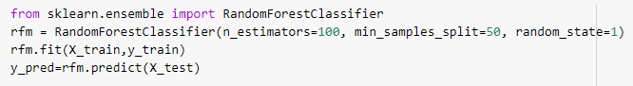
Random Forest
Tesla
Twitter
Precision Score: 64.29%
Precision Score: 75%
NIO
META
Precision Score: 39.13%
Precision Score: 41.46%

Slide 13
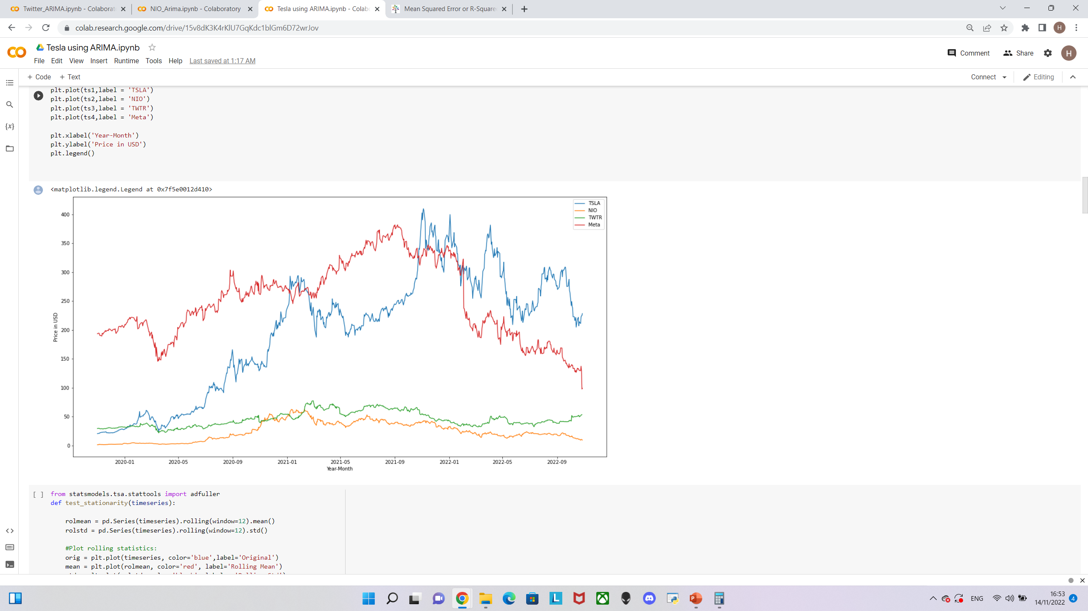
Time series analysis and forecast
Trends of Stock Price Movements for the past 3 years
TESLA (TSLA)
TWITTER (TWTR)
NIO (NIO)
META (META)

Slide 14
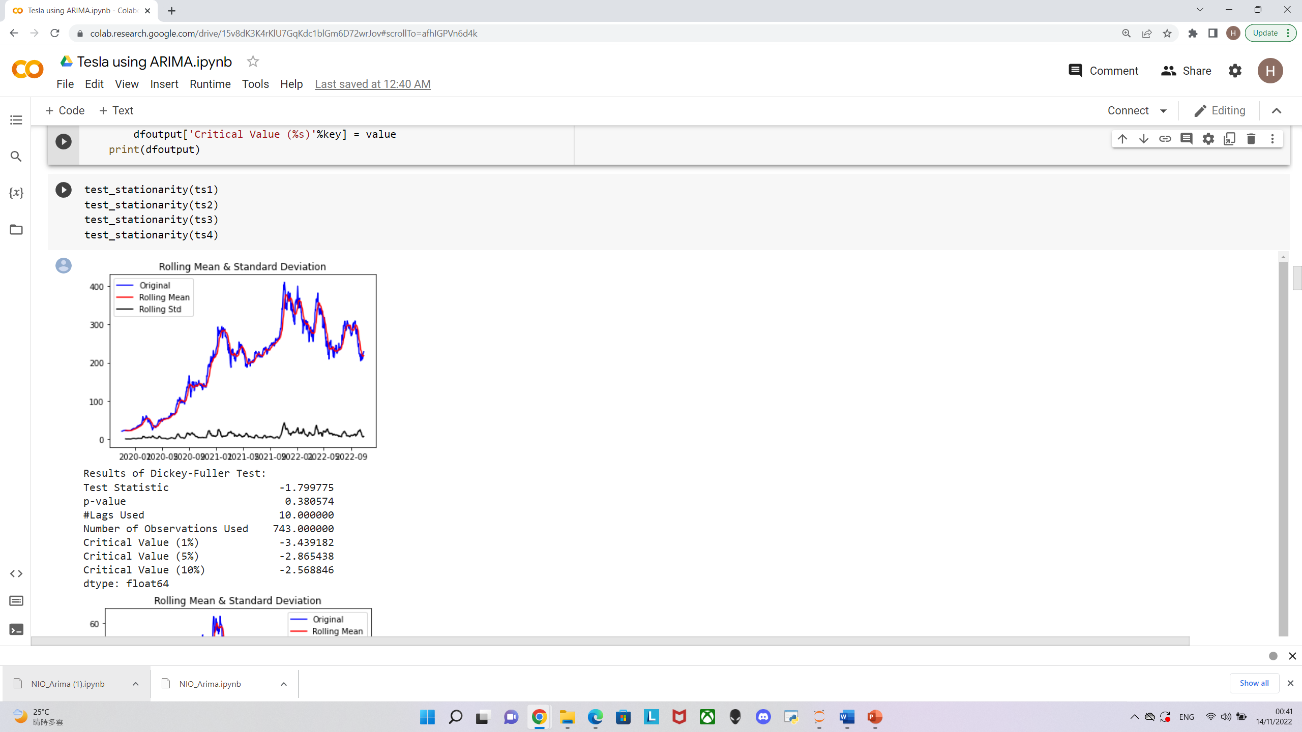
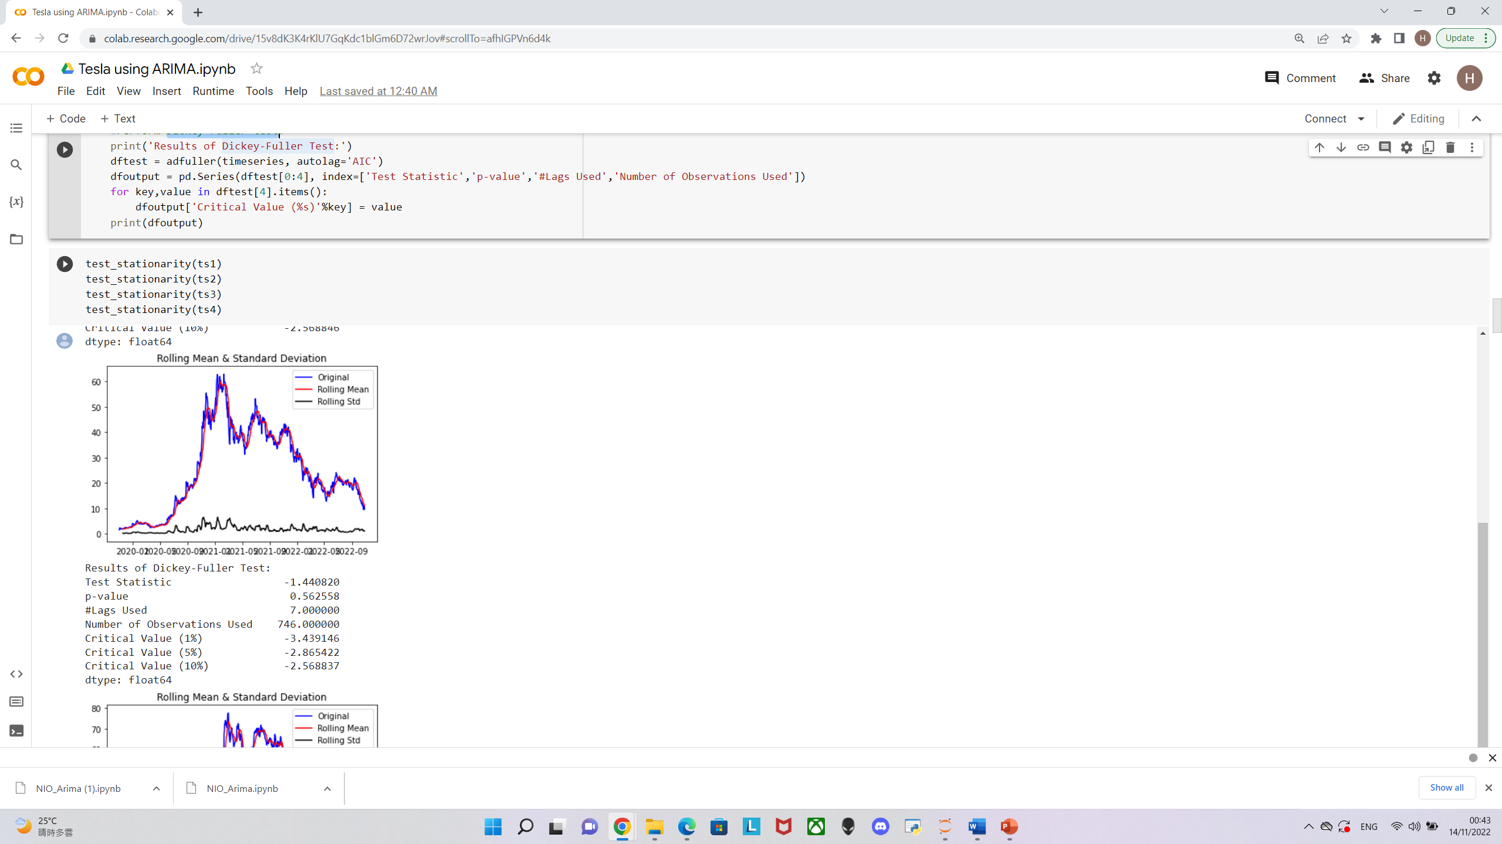
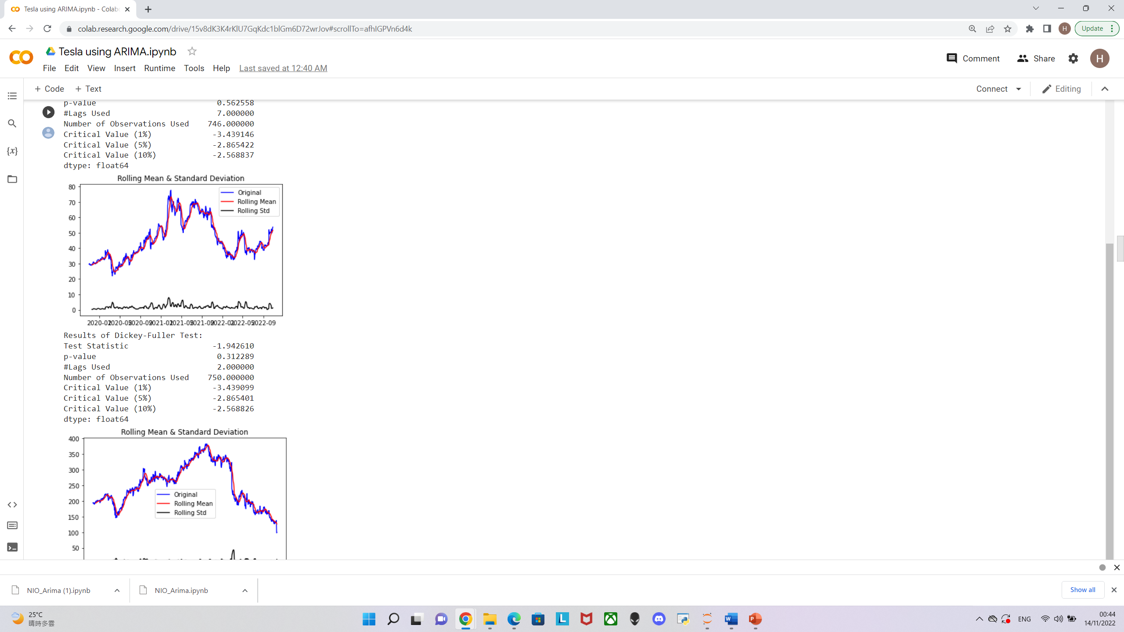
Time series analysis and forecast
Stationary Test (Dickey-Fuller test)
Performed on all three stocks for screening
Tesla
Twitter
NIO
Double log transformation
Quadrupled log transformation
Double log transformation
Transforming to Stationary Series

Slide 15
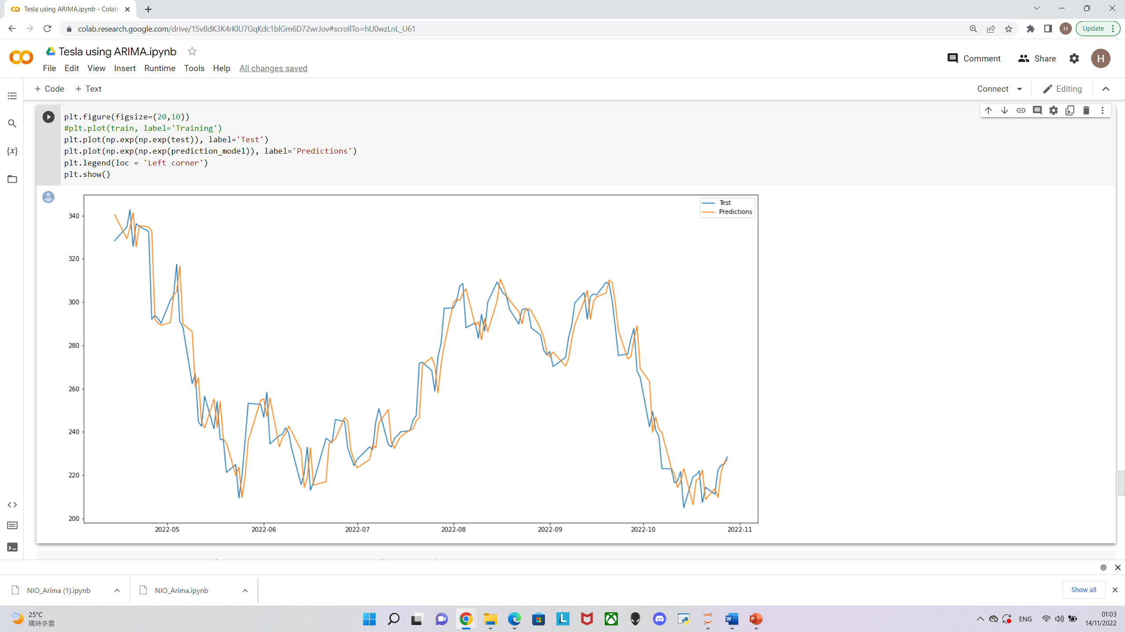
ARIMA on Tesla (TSLA)
Root mean squared should be much smaller than the mean value of test set.
Root Mean Squared Error: 10.49
Mean: 263.68
01
02
Average error 10.49/263.21 *100 = 3.98% of the actual value.

Slide 16
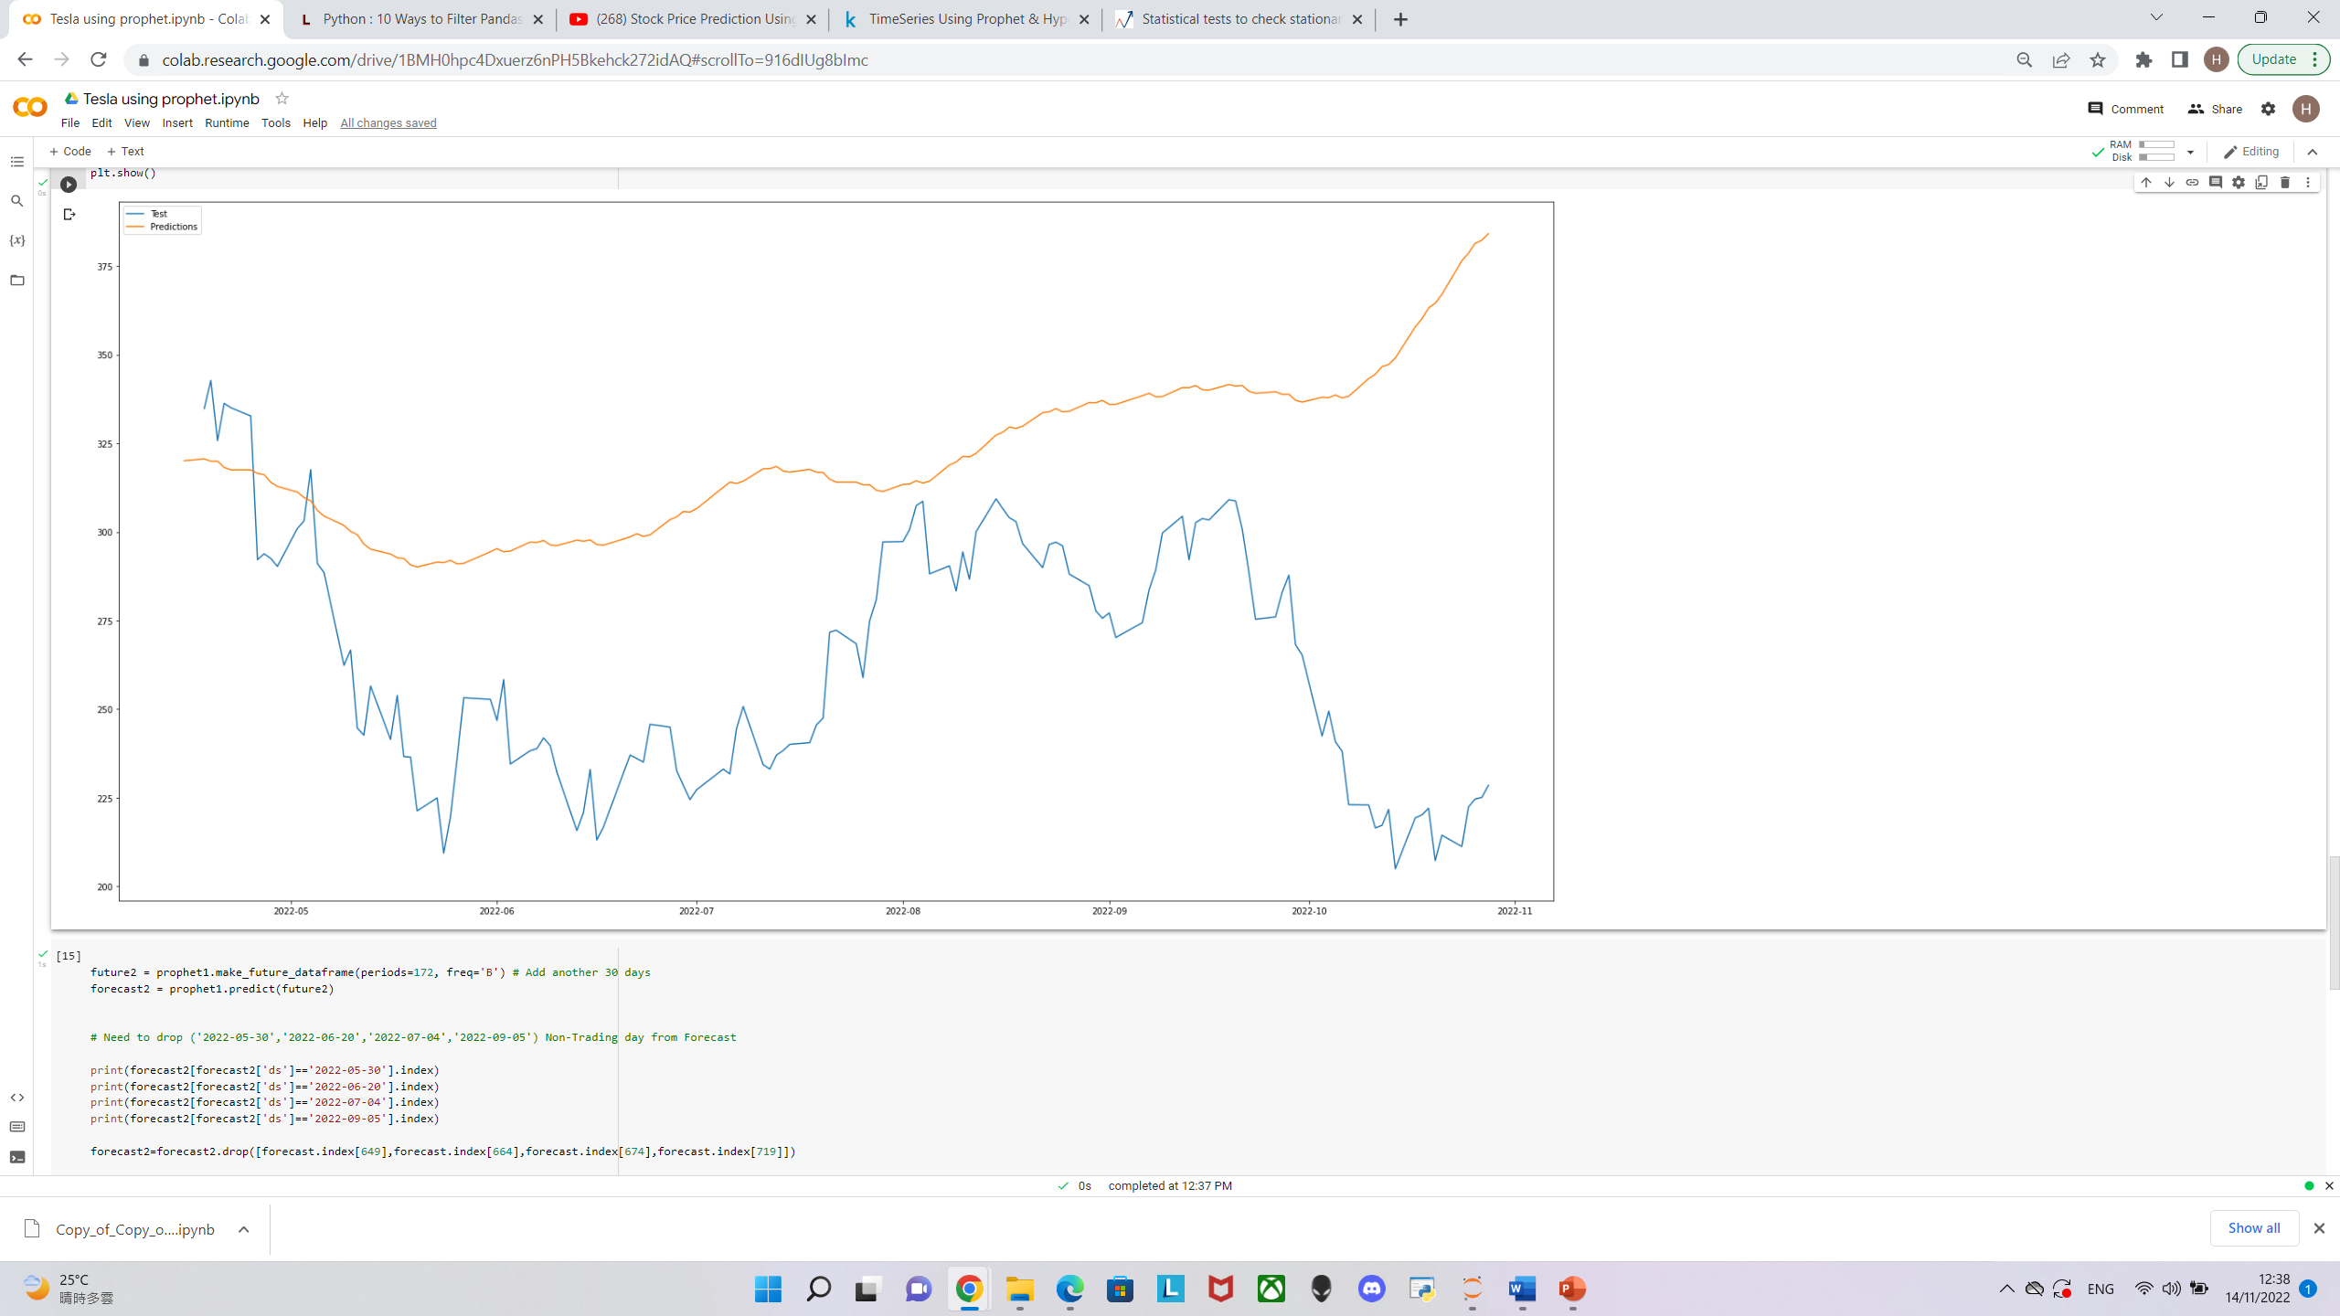
Prophet on Tesla (TSLA)
Root mean squared should be much smaller than the mean value of test set.
Root Mean Squared Error: 70.45
Mean: 263.68
01
02
Average error 70.45/263.21 *100 = 26.76% of the actual value.

Slide 17
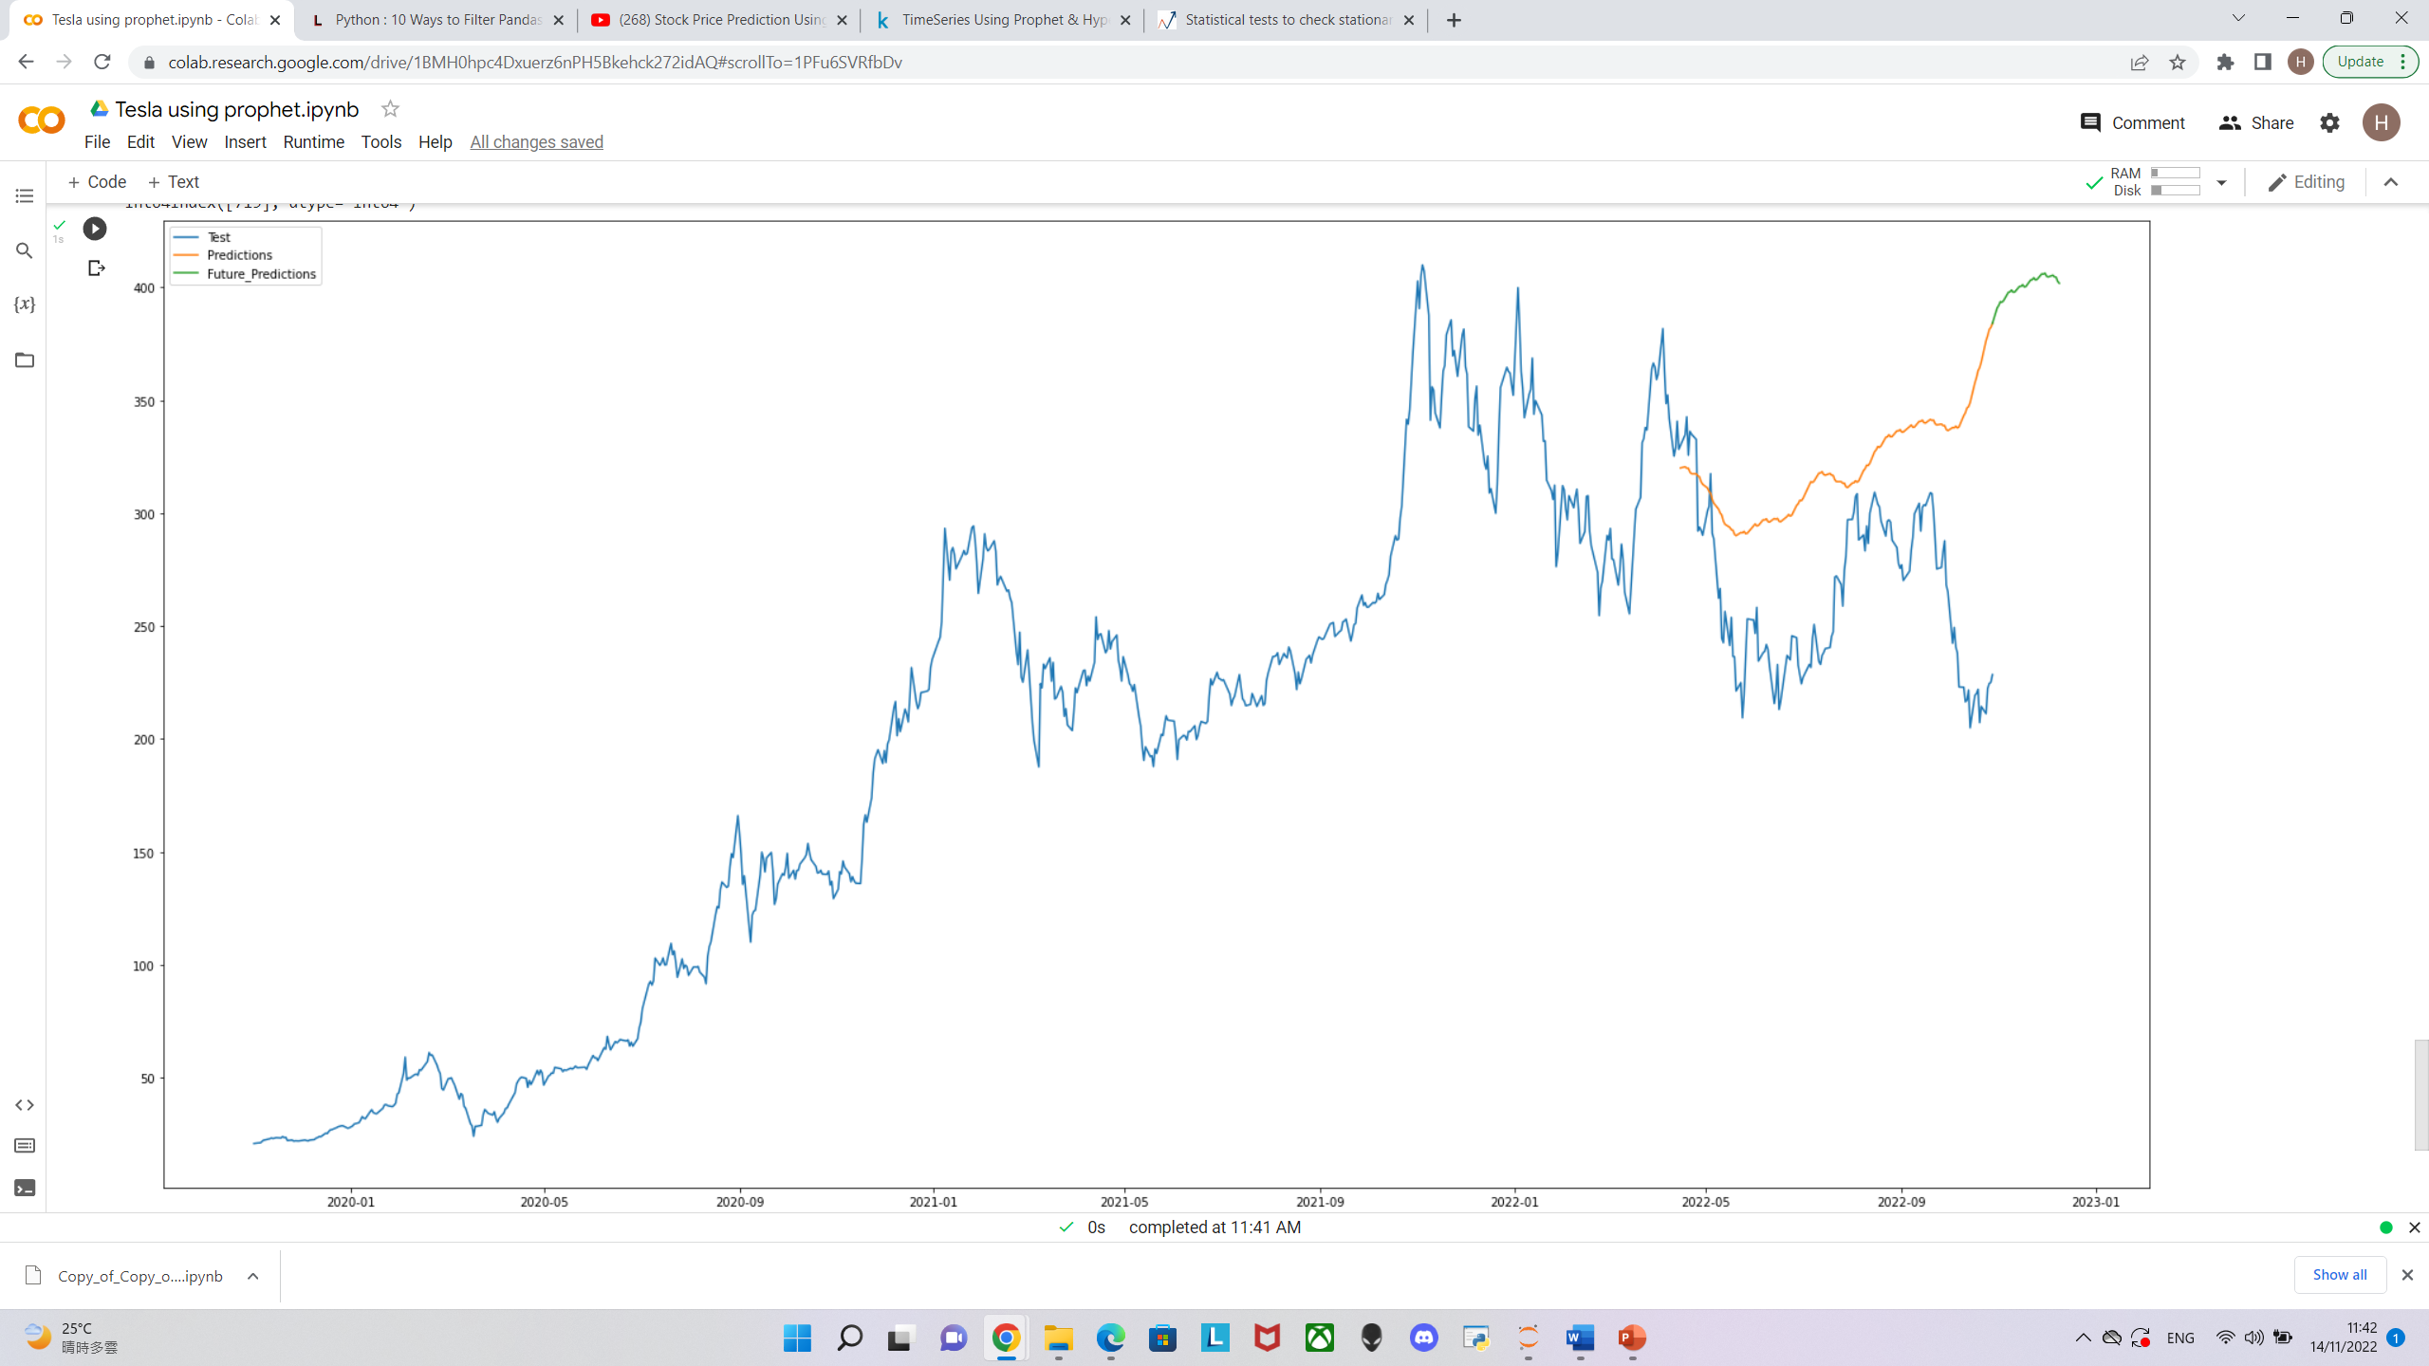
Prophet on Tesla (TSLA)

Slide 18
Why might Prophet have less accuracy?
ARIMA
Dependence on past realizations is completely ignored. In the real-world, a single, large shock will quickly change the whole future projection of the time-series which is not accounted for.
Variance is presumed to be constant. if random shocks have impact on the future, variance - as a measure of uncertainty - should grow
additive regression model, Rather a curve-fitting task
auto-regressive assumption, dependent on past data/ realizations.
Prophet

Slide 19
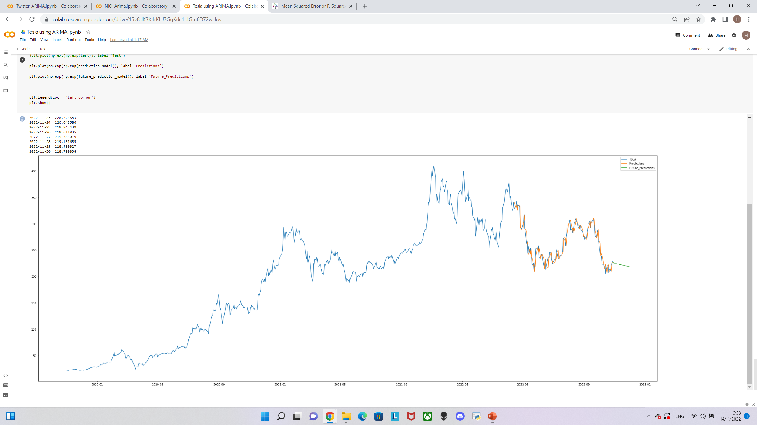
Time series analysis and forecast
ARIMA on Tesla (TSLA)
Root Mean Squared Error: 10.49
Mean: 263.68
Average error 10.49/263.68 *100 = 3.98% of the actual value.

Slide 20
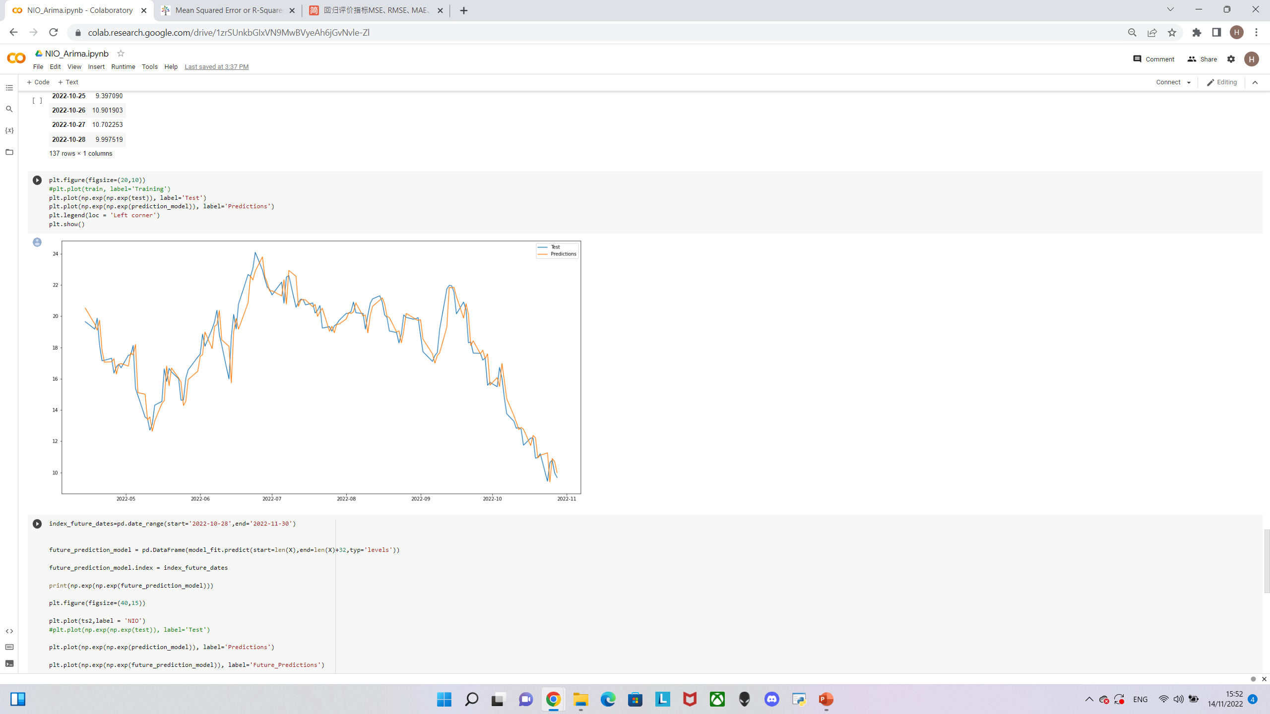
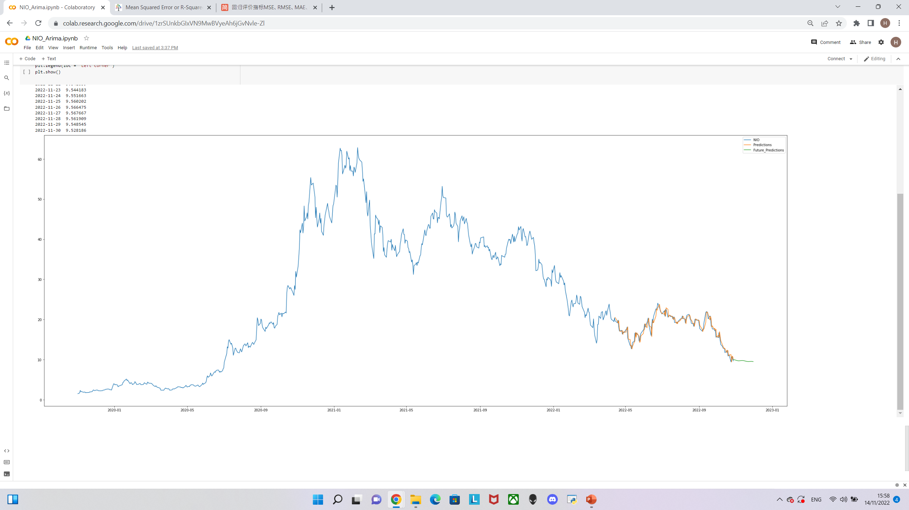
Time series analysis and forecast
ARIMA on NIO (NIO)
Root Mean Squared Error: 0.92
Mean: 17.98
Average error 0.92/17.98 *100 = 5.12% of the actual value.

Slide 21
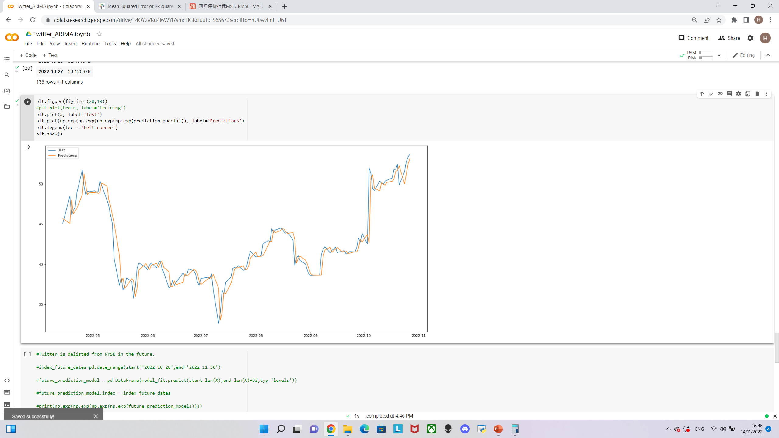
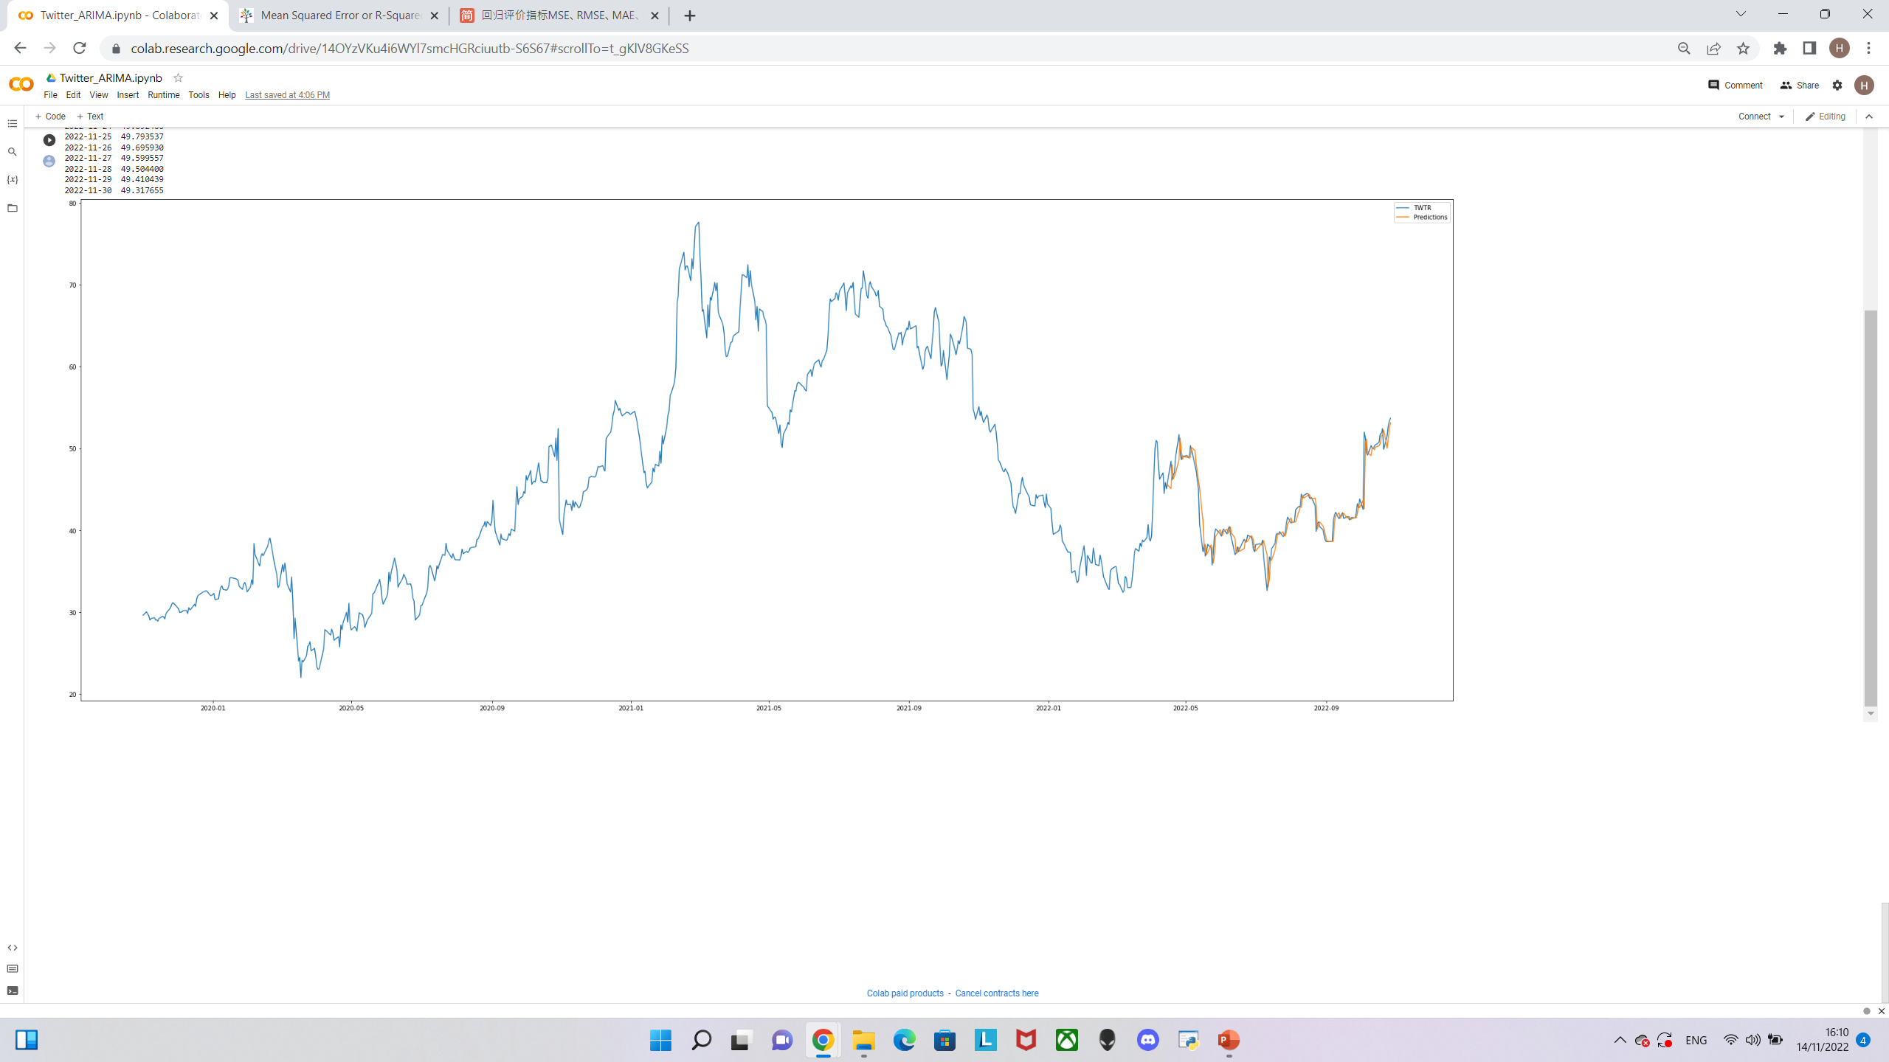
Time series analysis and forecast
ARIMA on Twitter (TWTR)
Root Mean Squared Error: 1.44
Mean: 42.69
Average error 1.44/42.69 *100 = 3.37% of the actual value.

Slide 22
Time series analysis and forecast
Conclusion
Large, long-term user-base of Facebook Prophet indicates that people value it
Prophet is simple and easy to use
Prophet should work fine as long as economy is in a non- volatile state
Both Stock Price of Tesla and Nio demonstrated a downward trend at least for a year and they are expected to be going down further until the end of November

Slide 23
Challenges, Limitation and Next Steps
Next Step
Limitation
02
Try to add more/quantify macroeconomic factors (adding more regressors) to the model to get an even more accurate forecasted result
Limitation
01
Tried to perform 4 times of log transformation on Twitter data series, results are still nonstationary
CHALLENGE 03
Lack of time to further study Time Series Using Prophet & Hyperparameter to optimizing the prophet model
Challenge
02
Challenge
01
Macroeconomic data, such as inflation, interest rate rise will also impact investor
Trend analysis may not be able to predict stock movement, other factor such as news, market behavior)
Existing model didn’t consider financials, management effectiveness, etc

